Slide 1

PROJECT WORK PRESENTATION COLLEGE MANAGEMENT SYSTEM SUBMITTED BY TANU SHREE HARISHMANIKANDAN MOHAN BALAJI VIMAL KUMAR V SAYALI BAFNA Under the guidance of Pooja Mehta

Slide 2
INTRODUCTION
The COLLEGE MANAGEMENT SYSTEM can be used to store student information, course, faculty, department etc. admin can edit, delete and add any student, course, subject using this system.
This System facilitates colleges to ,maintain the functionality related to college employees and their students.
College Management System provides the easiest way to manage all functionalities of a college.

Slide 3
OBJECTIVE
The main objective of college management system is to automate all functionalities of a college.
Using this system you can manage all college student details , faculty details, course details, subject details etc.
College Management System enables you to view or update data and information about students and staff easily.

Slide 4
Technologies Used
Java 8
Spring Boot 2.2.6+
Spring Framework 5.2.5+
Maven 3.2
Spring Data JPA( Hibernate)
MySQL
Thymeleaf

Slide 5
REQUIREMENT SPECIFICATIONS
Hardware Configuration
Software Configuration
System : i3 2nd gen
RAM : 2 GB
Hard Disk : 10 GB
Operating System : Windows 8 & above
Software IDE : Eclipse
Language : Java
Back End : My SQL server

Slide 6
Proposed System
This is a web-related application that permits us to approach the entire knowledge regarding the college, employees, students, faculties etc.
In order to solve these problems, a new system has been created, that attempts to operate the whole procedure considering the database integration approach.

Slide 7
Spring Annotations
@Service | @Service annotation is used with classes that provide some business functionalities. Spring context will auto detect these classes when annotation-based configuration and class path scanning is used.
@Id | This annotation is used to specify the primary key generation strategy to use i.e., Instructs database to generate a value for this field automatically.
@GeneratedValue | Provides for the specification of generation strategies for the values of primary keys. The Generated Value annotation may be applied to a primary key property or field of an entity or mapped superclass in conjunction with the Id annotation.
@Transactional | @Transactional annotation is the metadata that specifies the semantics of the transactions on a method. We have two ways to rollback a transaction: declarative and programmatic.
@Entity | The @Entity annotation specifies that the class is an entity and is mapped to a database table.
@Controller | @Controller annotation indicates that a particular class serves the role of a controller. There is no need to extend any controller base class or reference the Servlet API.
@ModelAttriibute | It is an annotation that binds a method parameter or method return value to a named model attribute, and then exposes it to a web view.

Slide 8
Spring Annotations
@ModelAttriibute | It is an annotation that binds a method parameter or method return value to a named model attribute, and then exposes it to a web view.
@RequestMapping | The @RequestMapping annotation can be applied to class-level and/or method-level in a controller.
@Autowired | The annotation @Autowired helps to auto wire the collaborative beans in spring boot framework.
@GetMapping | This annotation is used for mapping HTTP GET requests onto specific handler methods
@Setter | This annotation is used update the value of a variable.
@Getter | This annotation is used to read the value of a variable
@Tostring | This annotation modifies the generated bytecode and creates an implementation of the toString()method.

Slide 9
CONCLUSION
The project entitled as College Management System is the system that deals with the issues related to a particular institution.
This project is successfully implemented with all the features mentioned in system requirements specification.
The project is designed keeping in view the day to day problems faced by a college.
Deployment of our application will certainly help the college to reduce unnecessary wastage of time in personally going to each department for some information.
Awareness and right information about any college is essential for both the development of student as well as faculty. So this serves the right purpose in achieving the desired requirements of both the communities.

Slide 10
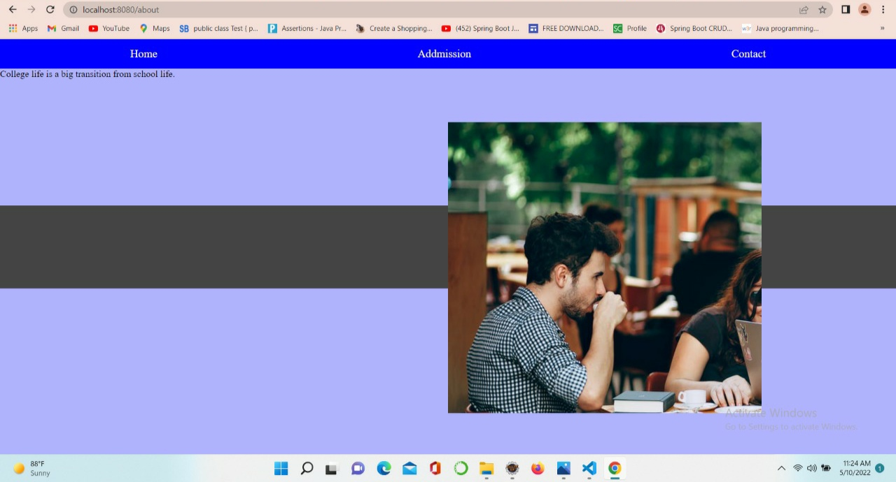
Project Snapshot

Slide 11
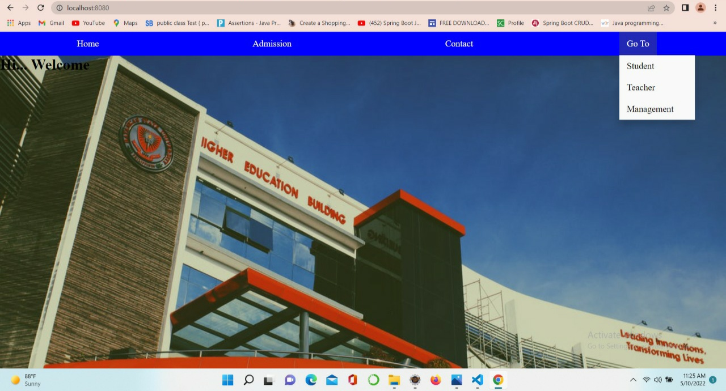

Slide 12
